Slide 1

Python Bootcamp

Slide 2
Course Description
Learn the essential foundations of python3 programming as one of employer’s most requested skills.
This course includes tutorials, real-world examples about reading and analyzing data, working with images and understanding essential python libraries and packages.

Slide 3
Prerequisites and Requirements
Basic computer skills like managing files from the command line
Basic algebra and programming knowledge in any language.
Computer running Windows, OS X or Linux

Slide 4
What you'll learn
Introduction to Python
Real-world use cases
Data Types
Operators
Control Flow
Functions
Analyzing external data
Popular python libraries (ex. NumPy, OpenCV)
Working Examples

Slide 5

Python History
First version of python in 1991
Python 2.0 in 2000 added new features.
Python3 released in 2008 (also called "Py3K“)
Worked with Google, Dropbox
Employed by Microsoft in 2020 to grow the python community.
Guido van Rossum
Python Programming language creator

Slide 6
Why Python?
Created to easily understand codes
Plenty of packages and libraries
Plenty of documentations (doc.python.org)
Cross-Platform (Windows, MAC OS, linux)
High market demand

Slide 7
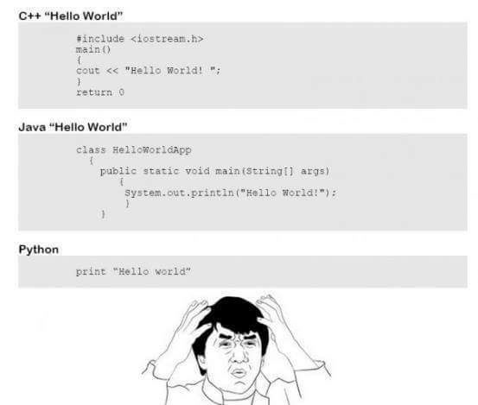
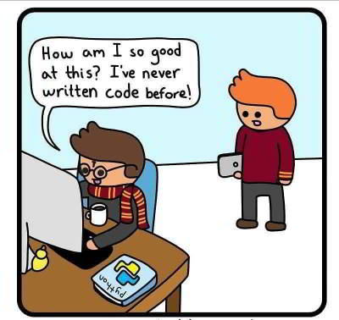

Slide 8
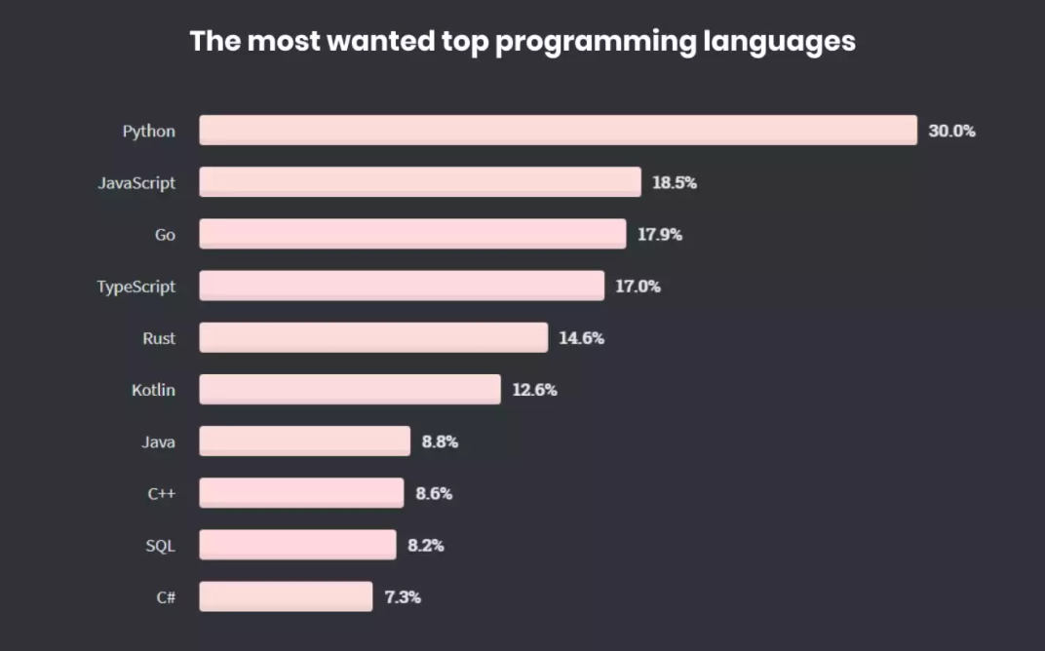
survey by Stack Overflow

Slide 9
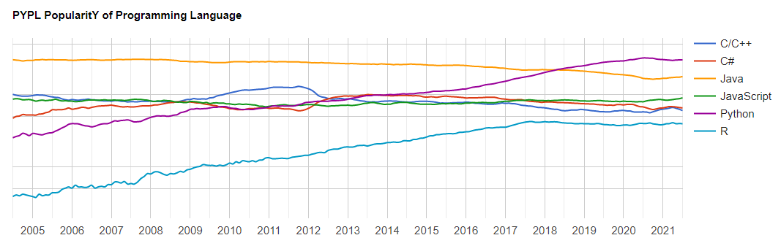
PYPL PopularitY of Programming Language Index

Slide 10
Why Python?
Tasks Automation
Reading Excel and Text files
Operations with PDF files
Search for files and edit its content
Scraping the web for information
Emails and messages automation
Filling forms automatically
And much more…

Slide 11
Why Python?
Data Science and Machine Learning
Data analysis
Create data visualization
Perform ML tasks and learn from input data
Create and run predictive algorithms

Slide 12
Why Python?
Web Development
Using web frameworks (Flask, django)
Manage backends for websites
Interactive user data page (Dashboards)

Slide 13
Why Python?
Desktop Apps Development
Deep Learning
Bot Systems
Game Development
Using web frameworks (Flask, django)
Manage backends for websites
Interactive user data page (Dashboards)

Slide 14
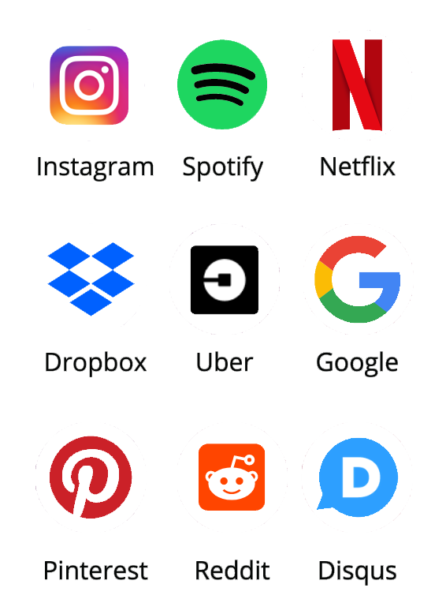




Who Uses Python?
Raspberry Pi
YouTube
Facebook
NASA

Slide 15

“Python where we can,
C++ where we must”
Alex Martelli, Senior Google Developer
We use python too

Slide 16
Installing Python

Slide 17
Python Installation Options
Text Editors (Sublime Text and Atom )
Full IDEs (PyCharm and Spyder)
Notebook Environments (Jupyter Notebook)
No Installation Online Platforms
Jupyter.org/try – Google Collab – Repl.it….and others.

Slide 18

Anaconda Distribution
Contains python and more than 700 additional packages used in Data Science.
Jupyter Notebook Included
Cross-platform
www.anaconda.com/downloads

Slide 19
Control Flow & Loops

Slide 20
Syntax of an if statement
if some_condition:
# execute some code

Slide 21
Syntax of an if statement
if some_condition:
# execute some code

Slide 22
Syntax of an if/else statement
if some_condition:
# execute some code
else:
# do something else

Slide 23
Syntax of an if/else statement
if some_condition:
# execute some code
elif some_other_condition:
# do something different
else:
# do something else

Slide 24
Syntax of a for loop
my_iterable = [1,2,3]
for item_name in my_iterable:
print(item_name)
>> 1
>> 2
>> 3

Slide 25
Syntax of a for loop
my_iterable = [1,2,3]
for item_name in my_iterable:
print(item_name)
>> 1
>> 2
>> 3

Slide 26
Syntax of a for loop
my_iterable = [1,2,3]
for item_name in my_iterable:
print(item_name)
>> 1
>> 2
>> 3

Slide 27
Syntax of a for loop
my_iterable = [1,2,3]
for item_name in my_iterable:
print(item_name)
>> 1
>> 2
>> 3

Slide 28
Syntax of a for loop
my_iterable = [1,2,3]
for item_name in my_iterable:
print(item_name)
>> 1
>> 2
>> 3

Slide 29
Syntax of a for loop
my_iterable = [1,2,3]
for item_name in my_iterable:
print(item_name)
>> 1
>> 2
>> 3

Slide 30
Syntax of a for loop
my_iterable = [1,2,3]
for item_name in my_iterable:
print(item_name)
>> 1
>> 2
>> 3

Slide 31
Syntax of a while loop
while some_boolean_condition: #do something

Slide 32
Syntax of a while loop
while some_boolean_condition: #do something
else:
#do something different

Slide 33
Functions

Slide 34
Syntax of a functions
def name_of_function():

Slide 35
Syntax of a functions
def name_of_function():

Slide 36
Syntax of a functions
def name_of_function():

Slide 37
Syntax of a functions
def name_of_function():

Slide 38
Syntax of a functions
def name_of_function():

Slide 39
Syntax of a functions
def name_of_function():
’’’
Docstring explains function.
’’’
print(“Hello”)
>> name_of_function()

Slide 40
Syntax of a functions
def name_of_function():
’’’
Docstring explains function.
’’’
print(“Hello”)
>> name_of_function()
>> Hello

Slide 41
Syntax of a functions
def name_of_function(name):
’’’
Docstring explains function.
’’’
print(“Hello ” + name)
>> name_of_function(“Ali”)
>> Hello Ali

Slide 42
Syntax of a functions
def name_of_function(name):
’’’
Docstring explains function.
’’’
print(“Hello ” + name)
>> name_of_function(“Ali”)
>> Hello Ali

Slide 43
Syntax of a functions
def population_density(population, land_area):
"""Calculate the population density of an area. """
return population / land_area
>> result = population_density(1701575, 760)
>> print(“The population density in Bahrain is {} per Km square.”.format(int(result))
>> The population density in Bahrain is 2239 per Km square.

Slide 44
Syntax of a functions
def population_density(population, land_area):
"""Calculate the population density of an area. """
return population / land_area
>> result = population_density(1701575, 760)
>> print(“The population density in Bahrain is {} per Km square.”.format(int(result))
>> The population density in Bahrain is 2239 per Km square.

Slide 45
Syntax of a functions
def population_density(population, land_area):
"""Calculate the population density of an area. """
return population / land_area
>> result = population_density(1701575, 760)
>> print(“The population density in Bahrain is {} per Km square.”.format(int(result))
>> The population density in Bahrain is 2239 per Km square.

Slide 46
Syntax of a functions
def population_density(population, land_area):
"""Calculate the population density of an area. """
return population / land_area
>> result = population_density(1701575, 760)
>> print(“The population density in Bahrain is {} per Km square.”.format(int(result))
>> The population density in Bahrain is 2239 per Km square.

Slide 47
Syntax of a functions
def population_density(population, land_area):
"""Calculate the population density of an area. """
return population / land_area
>> result = population_density(1701575, 760)
>> print(“The population density in Bahrain is {} per Km square.”.format(int(result))
>> The population density in Bahrain is 2239 per Km square.

Slide 48
Reading text files

Slide 49
Suppose we have the file my_file.txt with the below text:
Hello,
This is python bootcamp course
Thank you for you’re participation
Then we can read the content of the file like this:
with open('my_path/my_file.txt', 'r') as f:
file_data = f.read()

Slide 50
Suppose we have the file my_file.txt with the below text:
Hello,
This is python bootcamp course
Thank you for you’re participation
Then we can read the content of the file like this:
with open('my_path/my_file.txt', 'r') as f:
file_data = f.read()

Slide 51
Suppose we have the file my_file.txt with the below text:
Hello,
This is python bootcamp course
Thank you for you’re participation
Then we can read the content of the file like this:
with open('my_path/my_file.txt', 'r') as f:
file_data = f.read()

Slide 52
Suppose we have the file my_file.txt with the below text:
Hello,
This is python bootcamp course
Thank you for you’re participation
Then we can read the content of the file like this:
with open('my_path/my_file.txt', 'r') as f:
file_data = f.read()

Slide 53
Suppose we have the file my_file.txt with the below text:
Hello,
This is python bootcamp course
Thank you for you’re participation
Then we can read the content of the file like this:
with open('my_path/my_file.txt', 'r') as f:
file_data = f.read()

Slide 54
Suppose we have the file my_file.txt with the below text:
Hello,
This is python bootcamp course
Thank you for you’re participation
Then we can read the content of the file like this:
with open('my_path/my_file.txt', 'r') as f:
file_data = f.read()

Slide 55
Suppose we have the file my_file.txt with the below text:
Hello,
This is python bootcamp course
Thank you for you’re participation
Then we can read the content of the file like this:
with open('my_path/my_file.txt', 'r') as f:
file_data = f.read()

Slide 56
Suppose we have the file my_file.txt with the below text:
Hello,
This is python bootcamp course
Thank you for you’re participation
Then we can read the content of the file like this:
with open('my_path/my_file.txt', 'r') as f:
file_data = f.read()

Slide 57
Suppose we have the file my_file.txt with the below text:
Hello,
This is python bootcamp course
Thank you for you’re participation
Then we can read the content of the file like this:
with open('my_path/my_file.txt', 'r') as f:
file_data = f.read()
print(file_data )

Slide 58
Thank you

